Slide 1

Toxic Comment Classification
Team 4: Kritika, Shivani, Arvind, Ishan

Slide 2
Toxic Comment Classification
Agenda
02
Our Approach
Overview of our Approach
05
03
Recommendations
Recommendations and Conclusion
Models Selection
Elaboration of Models used – Best model
01
Introduction
Problem Statement
04
Results
Results obtained
Data Mining and Business Intelligence
02

Slide 3

Toxic Comment Classification
Toxic Comment Classification
Introduction
Current Situation
Future Situation
The Conversation AI team, a research initiative founded by Jigsaw and Google are working on tools to help improve online conversation
The current models are not accurate in categorizing the toxic comments across different platforms
The AI Team has a model that accurately classify toxic comments and detect different types of toxicity like threats, obscenity, insults, and identity-based hate better than past models.
Better Online conversations
A classification model that classifies text data into six categories:
toxic, severe toxic, obscene, identity threat, insult, hatred
0 3

Slide 4





Toxic Comment Classification
Toxic Comment Classification
Our Approach
Data Exploration
Data Preprocessing
Model Building
Model Selections
Recommendations
Data Exploration
Data Preprocessing
Model Building
Model Selections
Recommendations
Performed EDA with the help of Word Clouds, Bar Graphs, Missing & Null Value Analysis
We removed the inconsistencies of the data for e.g. Removing irregularities, stop words, lemmatizing, vectorization etc
We have developed our models example: Logistic, Logistic+ Decision Tree, Naïve Bayes
Models tried
Logistic Regression
+ Boosted Tree
Improve Online Conversations through sophisticated classification models
0 4

Slide 5
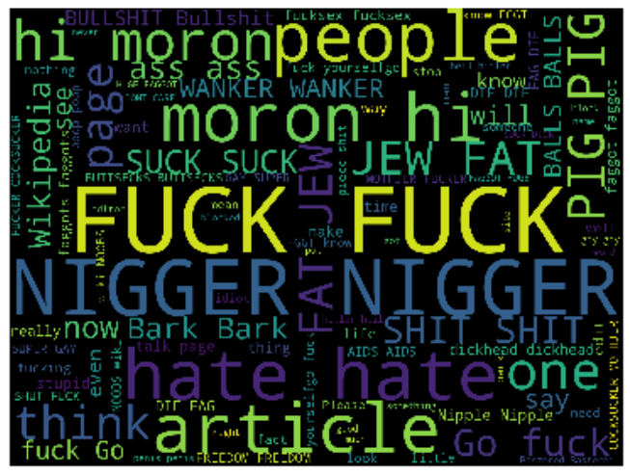
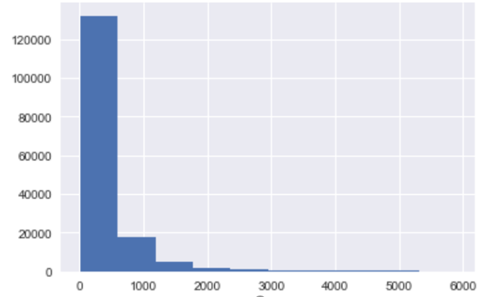
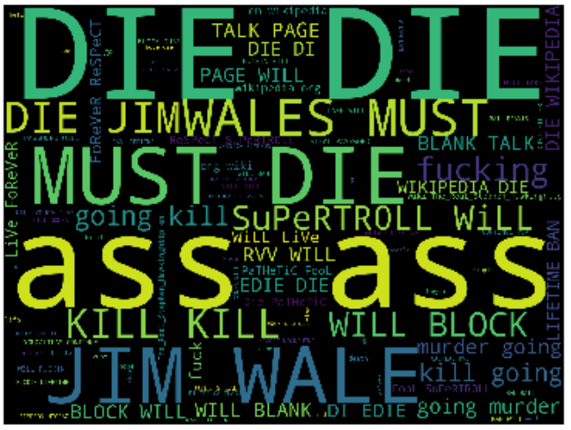
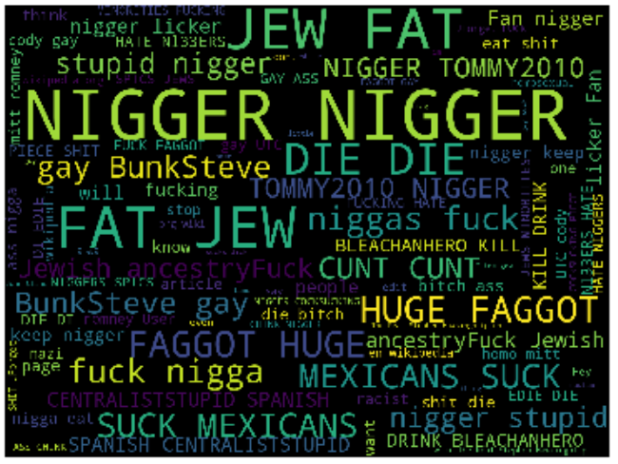
Toxic Comment Classification
Toxic Comment Classification
Our Approach : Exploratory Data Analysis
Category – Toxic Comments
Toxic Comment Length
Category - Threat
Category – Identity Threat
0 5

Slide 6
Toxic Comment Classification
2
Toxic Comment Classification
Our Approach : Data Preprocessing
2
Lemmatizing
Removing Irregularities
Lemmatization to chop off the endings to return dictionary base form .
Substitution of words from their short forms to full forms
TFIDF Vectorization
Stop Words Removal
TF: Measures how frequently a term occurs in a document
IDF: Measures how important a term is.
Removing words with no significance to data
0 6

Slide 7
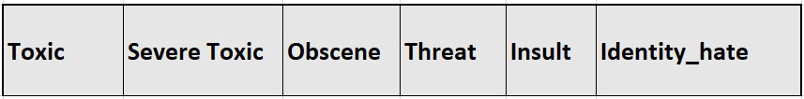
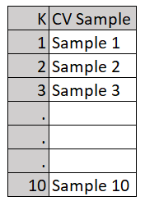
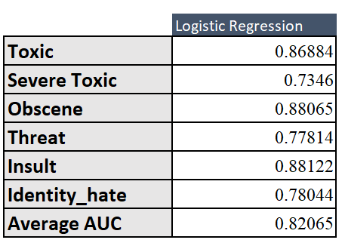


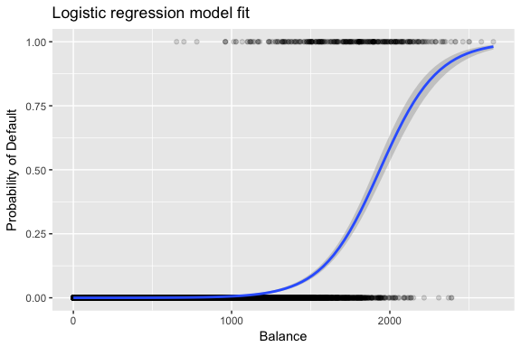

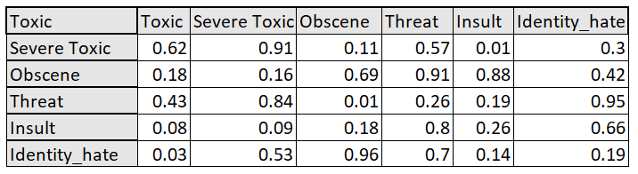
Toxic Comment Classification
Toxic Comment Classification
Toxic Comment Classification
Model Used: Logistic Regression
Model Selection: Logistic Regression
LOGISTIC REGRESSION
Logistic Regression is a classification technique which predicts a categorical outcome by computing the log odds of the dependent variable using a logit function
APPROACH 1-BINARY RELEVANCE
CROSS VALIDATION
MODEL SUMMARY
MODEL OUTPUT
Model 1
Model 2
Model 3
Model 6
APPROACH 2-CLASSIFIER CHAINS
CORRELATION
CLASSIFIER CHAINS
CROSS VALIDATION
MODEL SUMMARY
COMMENT
MODEL 1
LABEL 1
MODEL 2
LABEL 2
MODEL 2
LABEL 3
0 7
0 7

Slide 8
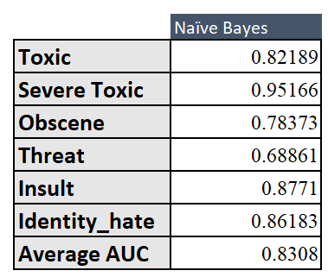
Toxic Comment Classification
Model Used: Naïve Bayes
NAIVE BAYES
MULTINOMIAL
It is a classification technique based on Bayes’ Theorem with an assumption of independence among predictors. The class with the highest posterior probability is the outcome of prediction.
APPROACH 1-BINARY RELEVANCE
CROSS VALIDATION
MODEL SUMMARY
MODEL OUTPUT
Model 1
Model 2
Model 3
Model 6
APPROACH 2-CLASSIFIER CHAINS
CORRELATION
CLASSIFIER CHAINS
CROSS VALIDATION
MODEL SUMMARY
COMMENT
MODEL 1
LABEL 1
MODEL 2
LABEL 2
MODEL 2
LABEL 3
0 8

Slide 9
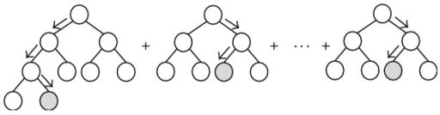
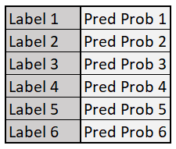
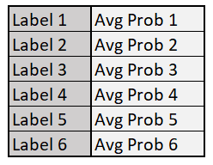
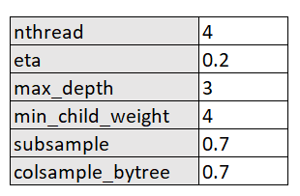
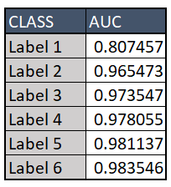
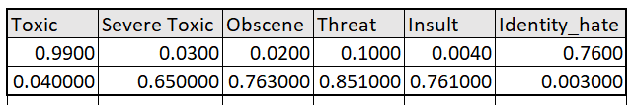
Toxic Comment Classification
Toxic Comment Classification
Model Used: Logistic Regression + Boosted Tree
Agenda
LOGISTIC REGRESSION
BOOSTED TREE
Logistic Regression is a classification technique which predicts a categorical outcome by computing the log odds of the dependent variable using a logit function
A classification algorithm that compute a sequence of simple trees, where each successive tree is built for the prediction residuals of the preceding tree.
APPROACH
Boosted Tree
(Boosted Tree-Label 1 Prob + Logistic Label 1 Prob
-------------------------------------------------------------------- 2
Logistic Regression
PARAMETERS
MODEL SUMMARY
MODEL OUTPUT
0 9

Slide 10
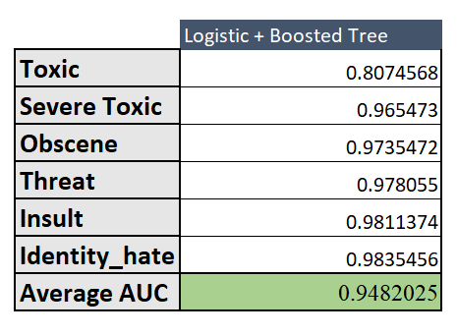
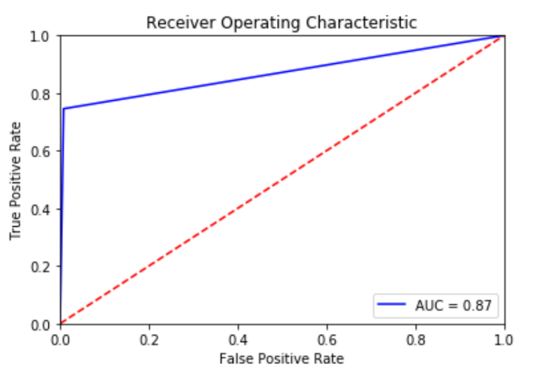
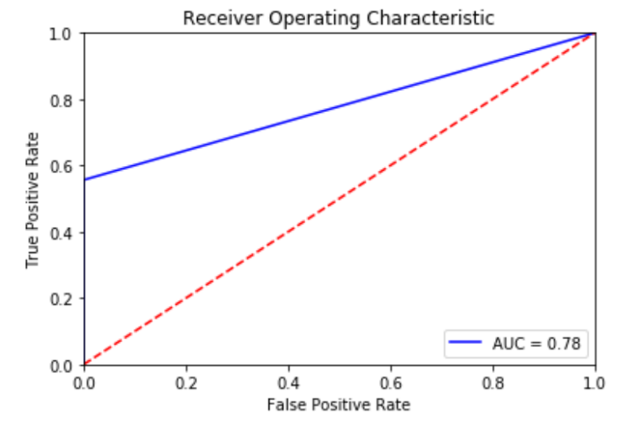
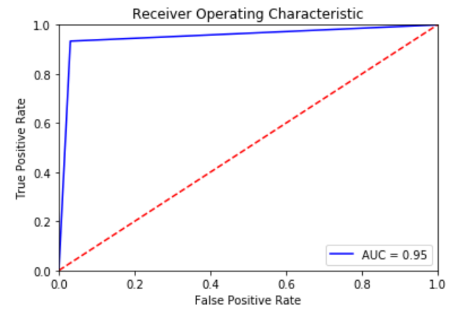
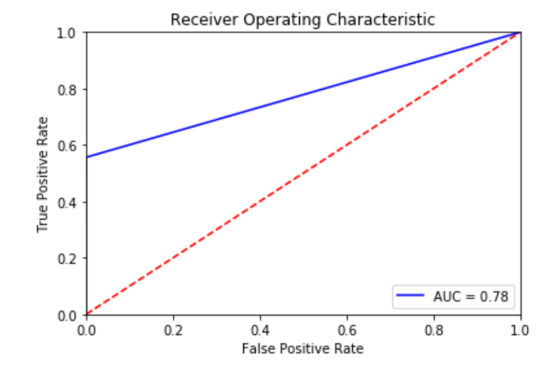
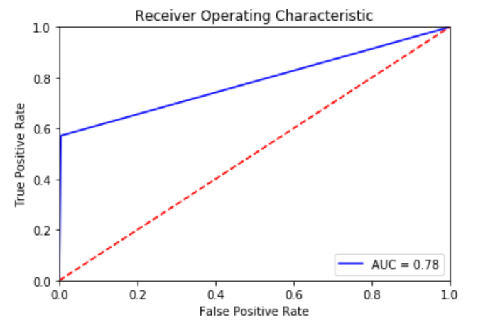
Toxic Comment Classification
Toxic Comment Classification
Results
MODEL 3-BEST MODEL
MODEL 1
MODEL 2
toxic
Threat
Severe toxic
hate
Obscene
Insult
0 9

Slide 11
Toxic Comment Classification
Toxic Comment Classification
Model Predictions
Accurately Classified Comments
Toxic
Toxic
Non Toxic
Misclassified Comments
10

Slide 12
Toxic Comment Classification
Toxic Comment Classification
Business Values
The toxic free online conversations/ comments can make the overall discussion informative and enjoyable at the same time
Automated Approach to remove the toxic words will also help the users/researchers to make efficient systems which can help them to prevent the toxic communications on other platforms as well.
An open social media without toxic comments can make social media a place where everyone can express their thoughts freely and learn from other’s experience.
Brand value of various firms are degraded specially because of the content that is shared on their platform.( example : Facebook, YouTube, various social media platforms )
11

